Slide 1


Welcome you all
MongoDB
D.Sakthivel
Assistant Professor & Trainer,
KGiSL Micro College
KGiSL Campus, Coimbatore – 641 035.

Slide 2
Day 2
MongoDB Database
MongoDB Collections
MongoDB Documents
Insert Single and Multiple Documents
Import Data into Collections
Find Single and Multiple Documents
MongoDB Sort Documents
Update Single and Multiple Documents
Delete Documents

Slide 3
Switch or Create a new MongoDB Database
MongoDB is a document-oriented open-source NoSQL database.
It is one of the most popular and widely used NoSQL databases.
A database is a place where data is stored in an organized way.
In MongoDB, databases are used to store collections.
A single MongoDB server can have multiple databases and a single MongoDB database can have multiple collections.
You can use MongoDB Shell or MongoDB Compass to create a new database.
MongoDB provides the use <database-name command to connect with the database.
If the specified database name does not exist then it creates it and set it as a current database.
For example, the following command switch to the "humanResouredb" database. If it does not exist then creates it.

Slide 4
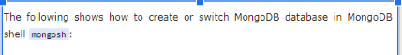
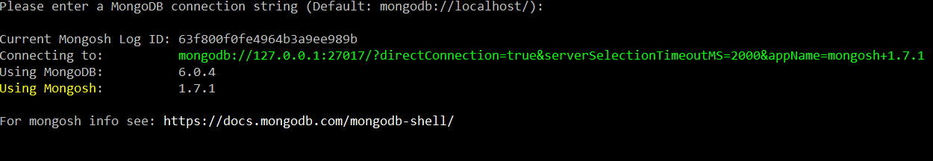
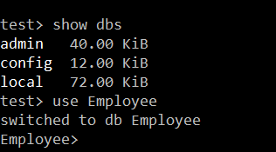

Slide 5
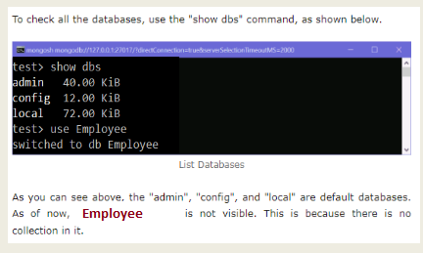
MongoDB will automatically switch to the newly created database. Notice that it promts to humanResourceDB> now.
To check all the databases, use the "show dbs" command, as shown below.
.

Slide 6
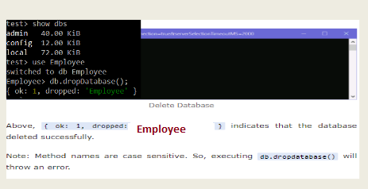
As you can see above, the "admin", "config", and "local" are default databases. As of now, "Employee" is not visible. This is because there is no collection in it.
To delete a database, use the db.dropDatabase() method which deletes a current database.

Slide 7
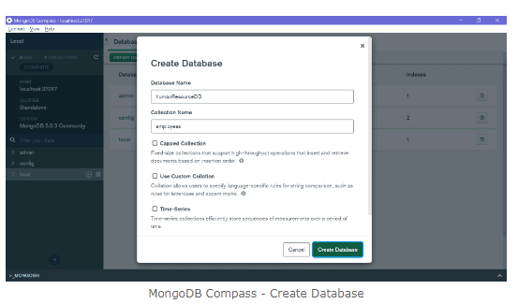
Create Database using MongoDB Compass
You can create a new database using MongoDB Compass. For that, open Compass and connect with your local or remote database.
Once it connects with the MongoDB server, click on the top "CREATE DATABASE" button which will open the popup window, as shown below.

Slide 8
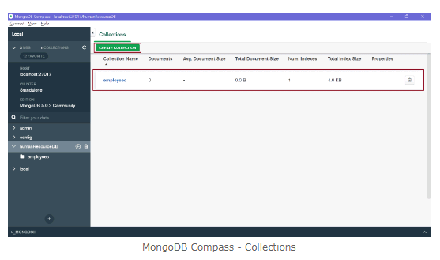
Create Database using MongoDB Compass
Enter your database name and collection name and click Create Database. This will create a new database humanResourceDB with the new employees collection shown below.
MongoDB Compass - CollectionsThus, you can create a new database in MongoDB.

Slide 9
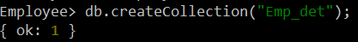
MongoDB Collections
A collection in MongoDB is similar to a table in RDBMS. MongoDB collections do not enforce schemas.
Each MongoDB collection can have multiple documents.
A document is equilant to row in a table in RDBMS.
To create a collection, use the db.createCollection() command.

Slide 10
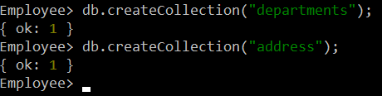
MongoDB Collections
Above, the employees collection is created using the createCollection() method.
It returns an object { ok: 1 }, which indicates the collection was created successfully.
As mentioned above, a single database can have multiple collections. The following creates multiple collections.

Slide 11
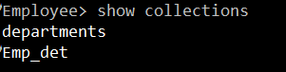
MongoDB Collections
Use the show collections commands to list all the collections in a database.
To Delete a collection:
Syntax:
db.collectionname.drop();
Example:
db.address.drop();

Slide 12
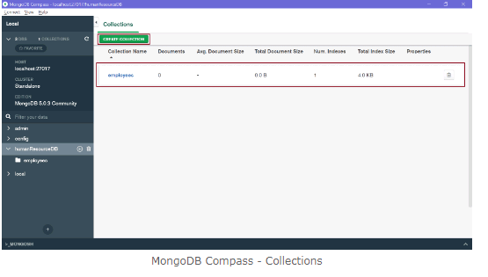
Create Collection in MongoDB Compass
To create a new collection using MongoDB Compass, connect compass to your server and select the database.
Click on the "Create Collection" button to create a new collection, as shown below.

Slide 13
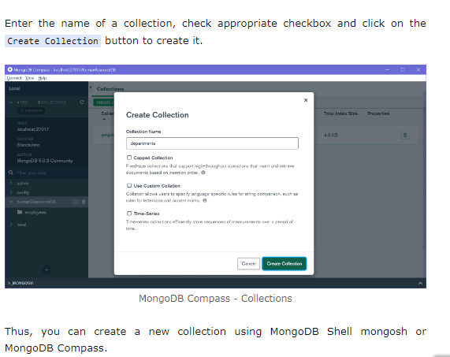
Create Collection in MongoDB Compass

Slide 14
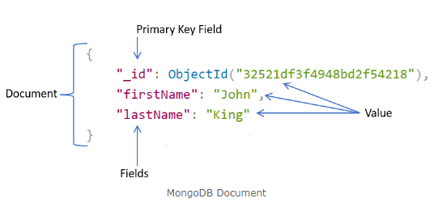
MongoDB Documents: Document, Array, Embedded Document
In the RDBMS database, a table can have multiple rows and columns.
Similarly in MongoDB, a collection can have multiple documents which are equivalent to the rows. Each document has multiple "fields" which are equivalent to the columns.
So in simple terms, each MongoDB document is a record and a collection is a table that can store multiple documents.
The following is an example of JSON based document.

Slide 15
MongoDB Documents: Document, Array, Embedded Document
In the above example, a document is contained within the curly braces. It contains multiple fields in "field":"value" format.
Above, "_id", "firstName", and "lastName" are field names with their respective values after a colon :. Fields are separated by a comma.
A single collection can have multiple such documents separated by a comma.

Slide 16
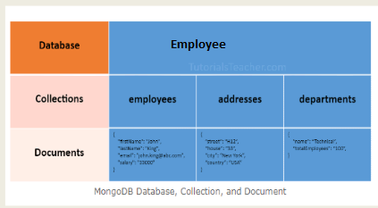
MongoDB Documents: Document, Array, Embedded Document
The following chart to understand the relation between database, collections, and documents.

Slide 17
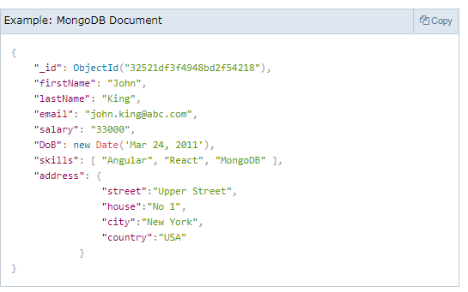
MongoDB Documents: Document, Array, Embedded Document
The following is an example of a document that contains an array and an embedded document.

Slide 18
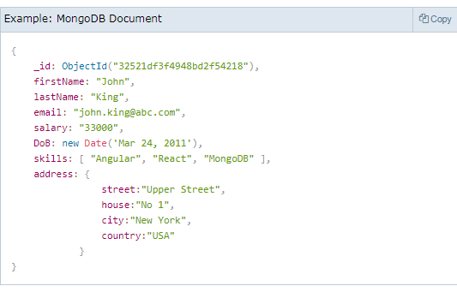
MongoDB document stores data in JSON format. In the above document, "firstName", "lastName", "email", and "salary" are the fields (like columns of a table in RDBMS) with their corresponding values (e.g value of a column in a row). Consider "_id" field as a primary key field that stores a unique ObjectId. "skills" is an array and "address" holds another JSON document.
The field names can be specified without surrounding quotation marks, as shown below.

Slide 19
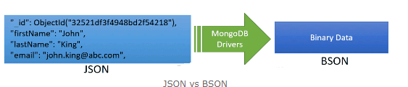
MongoDB stores data in key-value pairs as a BSON document. BSON is a binary representation of a JSON document that supports more data types than JSON. MongoDB drivers convert JSON document to BSON data.

Slide 20
Important Points:
MongoDB reserves _id name for use as a unique primary key field that holds ObjectId type. However, you are free to give any name you like with any data type other than the array.
A document field name cannot be null but the value can be.
Most MongoDB documents cannot have duplicate field names. However, it depends on the driver you use to store a document in your application.
A document fields can be without quotation marks " " if it does not contain spaces, e.g. { name: "Steve"}, { "first name": "Steve"} are valid fields.
Use the dot notation to access array elements or embedded documents.

Slide 21
Important Points:
6. MongoDB supports maximum document size of 16mb. Use GridFS to store more than 16 MB document.
7. Fields in a BSON document are ordered. It means fields order is important while comparing two documents, e.g. {x: 1, y: 2} is not equal to {y: 2, x: 1}.
8. MogoDB keeps the order of the fields except _id field which is always the first field.
9. MongoDB collection can store documents with different fields. It does not enforce any schema.

Slide 22
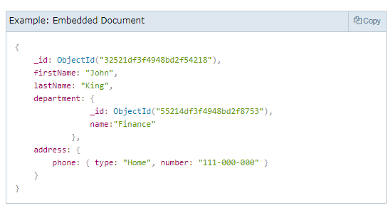
Embedded Documents:
A document in MongoDB can have fields that hold another document. It is also called nested documents.
The following is an embedded document where the department and address field contains another document.

Slide 23
Embedded Documents:
In the above embedded document, notice that the address field contains the phone field which holds a second level document.
An embedded document can contain upto 100 levels of nesting.
Supports a maximum size of 16 mb.
Embedded documents can be accessed using dot notation embedded-document.fieldname, e.g. access phone number using address.phone.number.

Slide 24
MongoDB - Insert Single Document in a Collection using insertOne()
In MongoDB, a collection represents a table in RDBMS and a document is like a record in a table. Learn how to insert a single document into a collection.
MongoDB provides the following methods to insert documents into a collection:
insertOne() - Inserts a single document into a collection.
insert() - Inserts one or more documents into a collection.
insertMany() - Insert multiple documents into a collection.

Slide 25
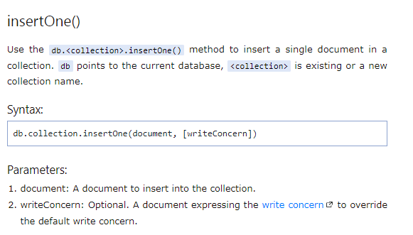
MongoDB - Insert Single Document in a Collection using insertOne()

Slide 26
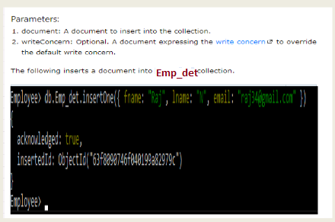
MongoDB - Insert Single Document in a Collection using insertOne()

Slide 27
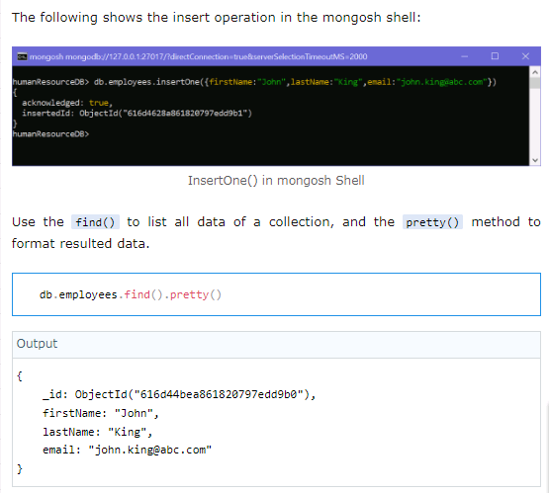
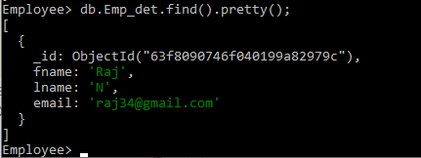
MongoDB - Insert Single Document in a Collection using insertOne()

Slide 28
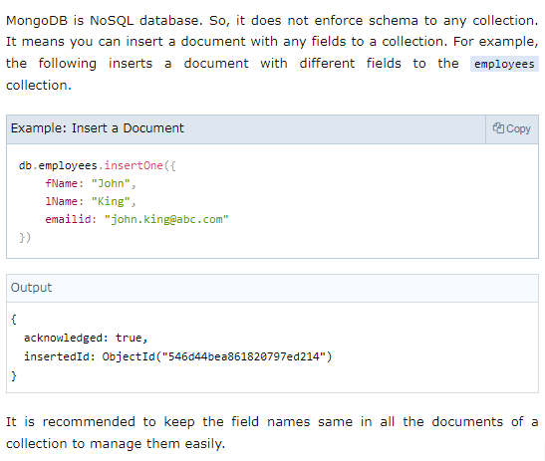
MongoDB - Insert Single Document in a Collection using insertOne()

Slide 29
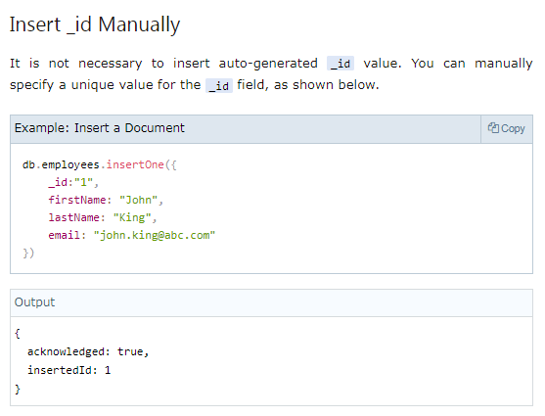
MongoDB - Insert Single Document in a Collection using insertOne()

Slide 30
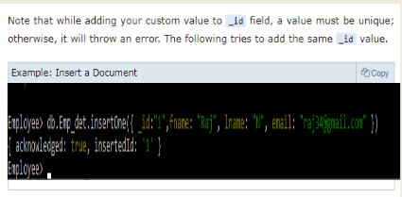
MongoDB - Insert Single Document in a Collection using insertOne()

Slide 31
MongoDB - Insert Multiple Documents in a Collection
In MongoDB, a collection represents a table in RDBMS and a document is like a record in a table. Learn how to insert one or more documents into a collection.
MongoDB provides the following methods to insert documents into a collection:
insertOne() - Inserts a single document into a collection.
insert() - Inserts one or more documents into a collection.
insertMany() - Insert multiple documents into a collection.

Slide 32
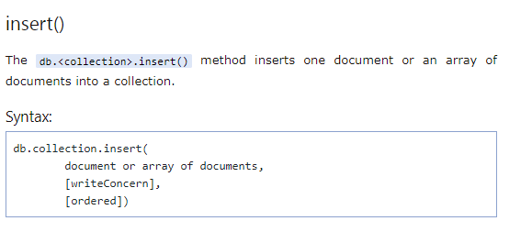
MongoDB - Insert Multiple Documents in a Collection

Slide 33
MongoDB - Insert Multiple Documents in a Collection
Parameters:
document or array of documents: A single document or array of documents to insert into the collection.
writeConcern: Optional. A document expressing the write concern to override the default write concern.
ordered: Optional. A boolean value indicating whether it's ordered or unordered insert operation. If true then performs ordered insert where if an error occurs with one of the documents, then MongoDB will return without processing the remaining documents in the array. If false, then process all the documents even if an error occurred. Defaults to true.

Slide 34
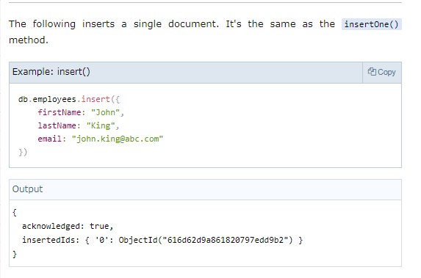
MongoDB - Insert Multiple Documents in a Collection

Slide 35
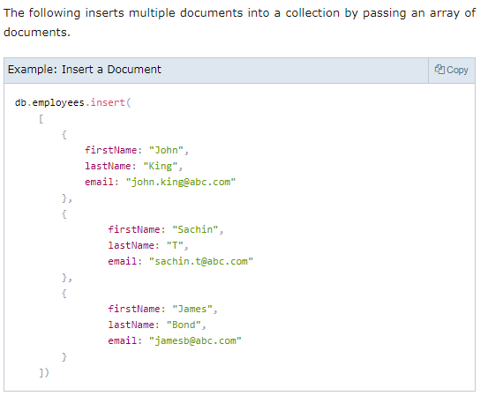
MongoDB - Insert Multiple Documents in a Collection

Slide 36
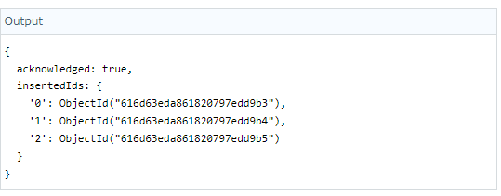
MongoDB - Insert Multiple Documents in a Collection

Slide 37
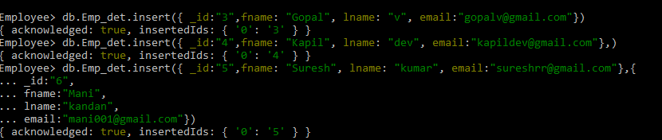
MongoDB - Insert Multiple Documents in a Collection

Slide 38
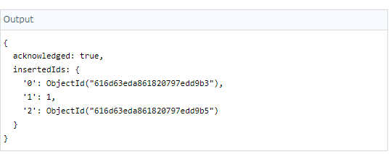
MongoDB - Insert Multiple Documents in a Collection

Slide 39
MongoDB - Insert Multiple Documents in a Collection

Slide 40
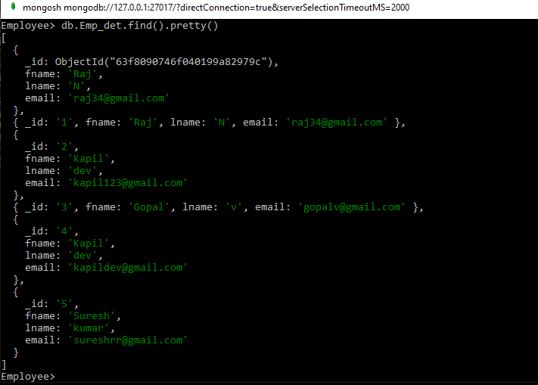
MongoDB - Insert Multiple Documents in a Collection
In the above output, it encounters an error while inserting the second document. So, it only inserts the first document. nInserted indicates the number of documents inserted successfully.

Slide 41
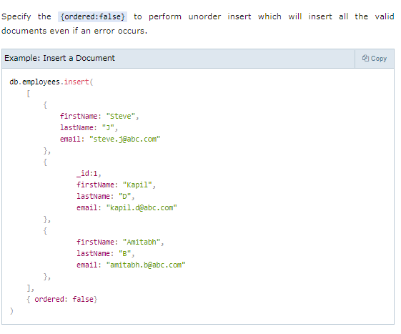
MongoDB - Insert Multiple Documents in a Collection

Slide 42
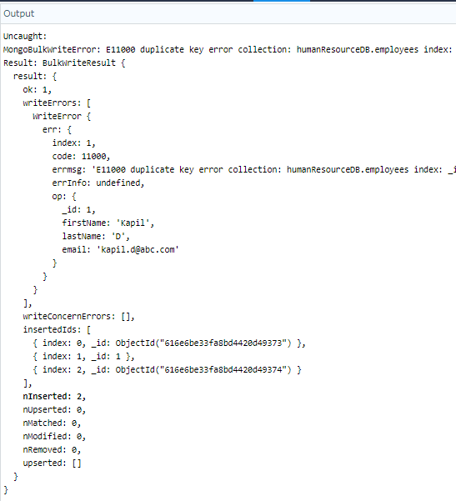
MongoDB - Insert Multiple Documents in a Collection

Slide 43
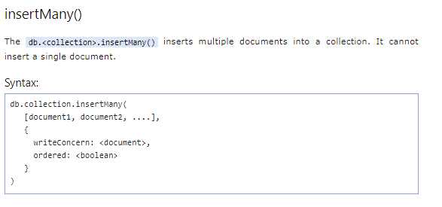
MongoDB - Insert Multiple Documents in a Collection

Slide 44
MongoDB - Insert Multiple Documents in a Collection
Employee> db.Emp_det.insertMany( [
{
_id: "11",
fname: "Ravi",
lname: "sharma",
email: "ravisharma@gmail.com"
},
{
_id: "12",
fname: "Moorthy",
lname: "R",
email: "murthy1258@gmail.com"
}
])
{ acknowledged: true, insertedIds: { '0': '11', '1': '12' } }

Slide 45
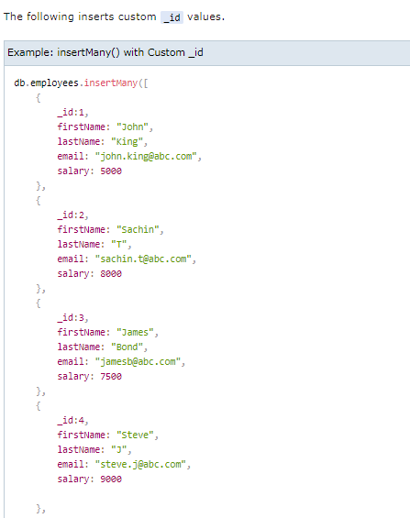
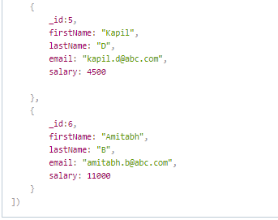
MongoDB - Insert Multiple Documents in a Collection

Slide 46
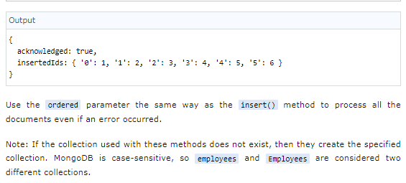
MongoDB - Insert Multiple Documents in a Collection

Slide 47
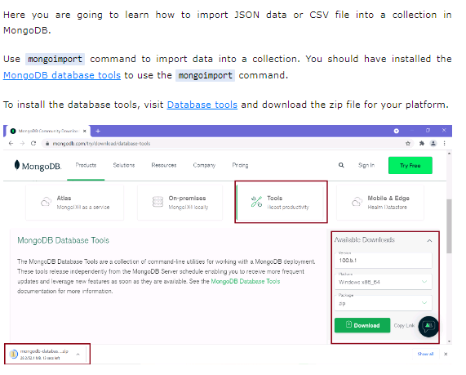
Import Data in MongoDB using Mongoimport

Slide 48
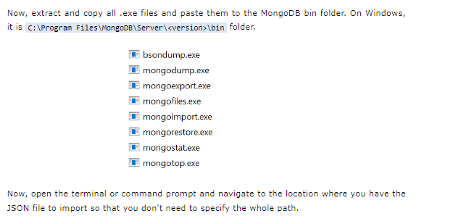
Import Data in MongoDB using Mongoimport

Slide 49
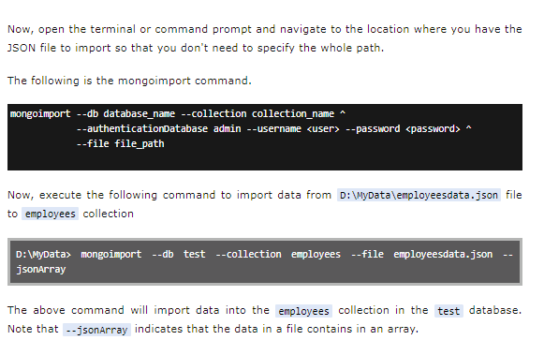
Import Data in MongoDB using Mongoimport

Slide 50
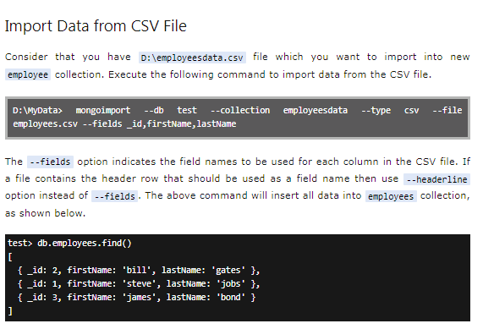
Import Data in MongoDB using Mongoimport

Slide 51
MongoDB: Find Single Document from Collection using findOne()
In MongoDB, a collection represents a table in RDBMS and a document is like a record in a table. Here you will learn how to retrieve or find a single document from a collection.
MongoDB provides two methods for finding documents from a collection:
findOne() - returns a the first document that matched with the specified criteria.
find() - returns a cursor to the selected documents that matched with the specified criteria.

Slide 52
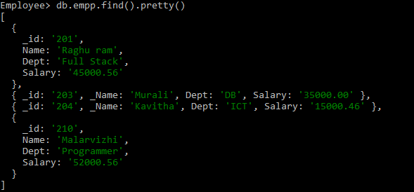
MongoDB: Find Single Document from Collection using findOne()

Slide 53
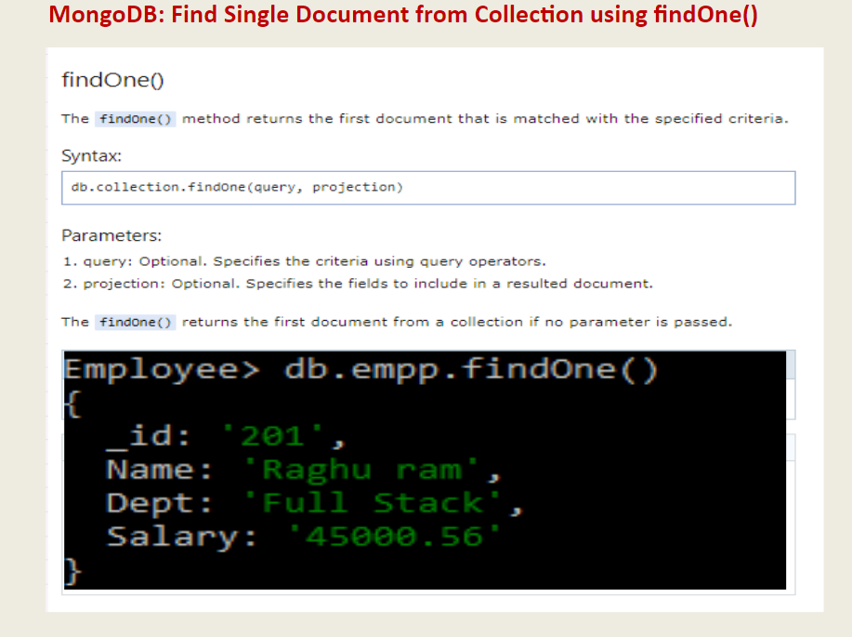
MongoDB: Find Single Document from Collection using findOne()

Slide 54
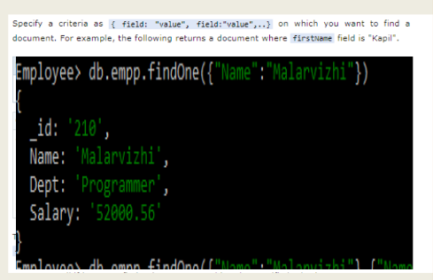
MongoDB: Find Single Document from Collection using findOne()

Slide 55
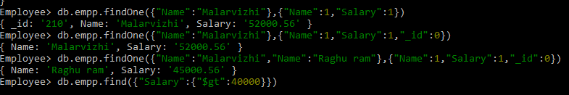
MongoDB: Find Single Document from Collection using findOne()

Slide 56
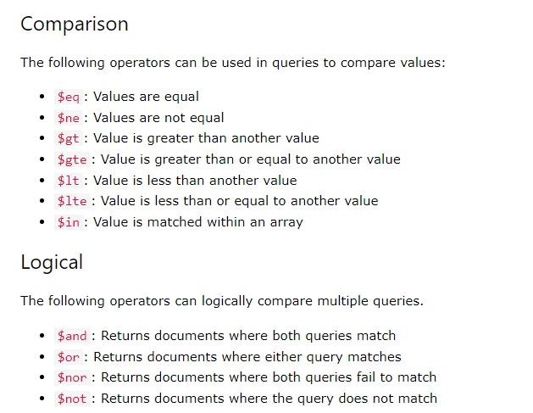
MongoDB: Query Operators in Collection using findOne()

Slide 57
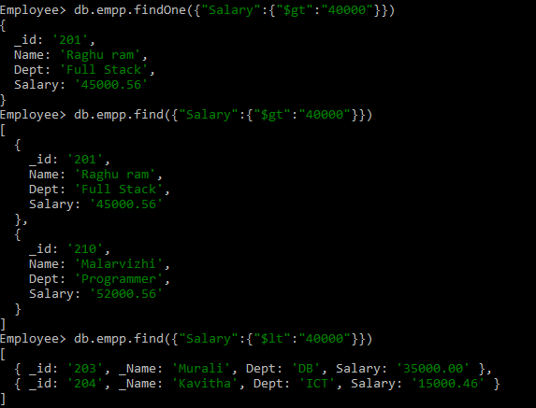
MongoDB: Query Operators in Collection using findOne()
In the above example, the query operator criteria for the salary field is written inside another document as {field: {operator: value}}. The {salary: {$gt: 8000}} criteria returns the first document where salary is greater than 8000.

Slide 58
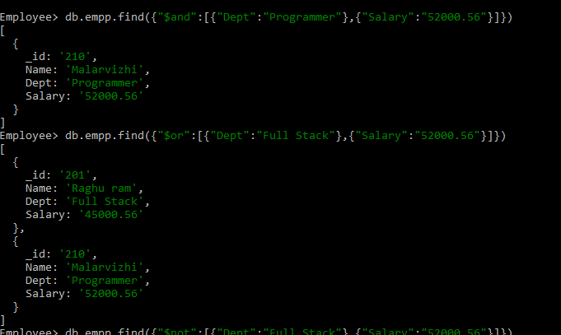
MongoDB: Logical Operators in Collection using findOne()

Slide 59
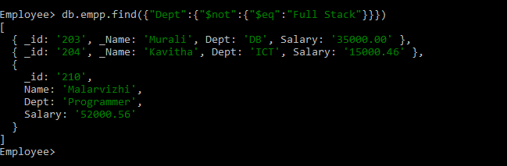
MongoDB: Logical Operators in Collection using findOne()

Slide 60

MongoDB: Sort()

Slide 61

MongoDB: Find Multiple Document from Collection using findOne()

Slide 62


MongoDB: Find Multiple Document from Collection using findOne()

Slide 63
MongoDB: Find Multiple Document from Collection using findOne()
Query Array Elements
You can find documents based on the array element, index, or size.
db.employees.find({ "skills": "Tax"}) //returns documents where skills contains "Tax“
db.employees.find({ "skills": { $in: [ "Tax", "Sales" ]}}) //returns documents where skills contains "Tax" or "Sales"
db.employees.find({ "skills": { $all: [ "Tax", "Accounting" ]}}) //returns documents where skills contains "Tax" and "Accounting"
db.employees.find({ "skills": { $size: 3}) //returns documents where skills contains 3 elements

Slide 64

MongoDB: Find Multiple Document from Collection using findOne()
Query Array Elements
You can find documents based on the array element, index, or size.

Slide 65

MongoDB: Find Multiple Document from Collection using findOne()
Query Array Elements
You can find documents based on the array element, index, or size.

Slide 66

MongoDB Cursor

Slide 67

MongoDB Cursor

Slide 68

MongoDB Cursor

Slide 69

MongoDB Cursor

Slide 70

MongoDB Cursor

Slide 71

MongoDB Cursor

Slide 72

Sort Documents in MongoDB Collection

Slide 73



Slide 74



Slide 75
Update Single Document using updateOne() in MongoDB
Learn how to update a single document using the updateOne() method in MongoDB.
MongoDB provides the following methods to update existing documents in a collection:
db.collection.updateOne() - Modifies a single document in a collection.
db.collection.updateMany() - Modifies one or more documents in a collection.

Slide 76

Update Single Document using updateOne() in MongoDB

Slide 77
Update Single Document using updateOne() in MongoDB
To demonstrate the update operation, insert the following sample documents in the employees collection.
Employee> db.prod_det.find().pretty()
[
{
_id: ObjectId("63f8b4742f75673b4213839c"),
Pid: '101',
Pname: 'HP',
price: '32500.99'
},
{
_id: ObjectId("63f8b4742f75673b4213839d"),
Pid: '102',
Pname: 'Lenovo',
price: '45999.99'
},

Slide 78
Update Single Document using updateOne() in MongoDB
{
_id: ObjectId("63f8b4742f75673b4213839e"),
Pid: '103',
Pname: 'Samsung',
price: '10000.00'
},
{
_id: ObjectId("63f8b4742f75673b4213839f"),
Pid: '104',
Pname: 'Nokia 1100',
price: '3500.00'
},
{
_id: ObjectId("63f8b4df2f75673b421383a0"),
Pid: '105',
Pname: 'Nokia G21',
price: '18500.99'
},

Slide 79
Update Single Document using updateOne() in MongoDB
{
_id: ObjectId("63f8b4df2f75673b421383a2"),
Pid: '113',
Pname: 'Samsung DX',
price: '20000.00'
},
{
_id: ObjectId("63f8b4df2f75673b421383a3"),
Pid: '114',
Pname: 'Oppo',
price: '13500.00'
}
]

Slide 80


Slide 81

Update Single Document using updateOne() in MongoDB
I

Slide 82

Update Single Document using updateOne() in MongoDB

Slide 83
Update Single Document using updateOne() in MongoDB
Employee> db.product_det.insertMany([
{ "Pid":"101", "Pname":"HP", "price":32500.99,"DOE":new Date("2022-10-24") },
{ "Pid":"102", "Pname":"Lenovo", "price":45999.99,"DOE":new Date("2023-01-21") },
{ "Pid":"103", "Pname":"Samsung", "price":10000.00,"DOE":new Date("2022-10-10") },
{ "Pid":"104", "Pname":"Nokia 1100", "price":3500.00,"DOE":new Date("2022-12-03")}])
{
acknowledged: true,
insertedIds: {
'0': ObjectId("63f8b9a12f75673b421383a4"),
'1': ObjectId("63f8b9a12f75673b421383a5"),
'2': ObjectId("63f8b9a12f75673b421383a6"),
'3': ObjectId("63f8b9a12f75673b421383a7")
}
}

Slide 84

Update Single Document using updateOne() in MongoDB

Slide 85

Update Single Document using updateOne() in MongoDB

Slide 86

Update Single Document using updateOne() in MongoDB

Slide 87

Update Single Document using updateOne() in MongoDB

Slide 88

Update Single Document using updateOne() in MongoDB

Slide 89

Update Multiple Documents using updateMany() in MongoDB

Slide 90

Update Multiple Documents using updateMany() in MongoDB

Slide 91

Update Multiple Documents using updateMany() in MongoDB
In the above syntax, db points to the current database, <collection> points is an existing collection name.

Slide 92

Update Multiple Documents using updateMany() in MongoDB

Slide 93


Slide 94


Slide 95


Slide 96


Slide 97
MongoDB: Update Arrays in Documents
Learn how to update array fields in documents in MongoDB collections.
You can use the updateOne() or updateMany() methods to add, update, or remove array elements based on the specified criteria. It is recommended to use the updateMany() method to update multiple arrays in a collection.
To demonstrate the update operation, insert the following sample documents in the employees collection.

Slide 98

MongoDB: Update Arrays in Documents

Slide 99

MongoDB: Update Arrays in Documents

Slide 100

MongoDB: Update Arrays in Documents

Slide 101

MongoDB: Update Arrays in Documents

Slide 102

MongoDB: Update Arrays in Documents

Slide 103

MongoDB: Update Arrays in Documents - OUTPUT

Slide 104

MongoDB: Update Arrays in Documents

Slide 105

MongoDB: Update Arrays in Documents

Slide 106

MongoDB: Update Arrays in Documents

Slide 107

MongoDB: Update Arrays in Documents

Slide 108

MongoDB: Update Arrays in Documents

Slide 109

MongoDB: Update Arrays in Documents

Slide 110

MongoDB: Update Arrays in Documents

Slide 111

MongoDB: Update Arrays in Documents

Slide 112
MongoDB: Delete Documents in a Collection
MongoDB provides the following methods to delete one or more documents in a collection.
db.collection.deleteOne() - Deletes the first matching document in a collection.
db.collection.deleteMany() - Deletes all the matching documents in a collection.

Slide 113

MongoDB: Delete Documents in a Collection

Slide 114

MongoDB: Delete Documents in a Collection

Slide 115
MongoDB: Delete Documents in a Collection

Slide 116


MongoDB: Delete Documents in a Collection

Slide 117

MongoDB: Delete Documents in a Collection

Slide 118

MongoDB: Delete Documents in a Collection

Slide 119



MongoDB: Drop Collection

Slide 120

Relations in MongoDB: One-to-One, One-to-Many, Many-to-Many

Slide 121

Relations in MongoDB: One-to-One, One-to-Many, Many-to-Many

Slide 122

Relations in MongoDB: One-to-One, One-to-Many, Many-to-Many

Slide 123

Relations in MongoDB: One-to-One, One-to-Many, Many-to-Many

Slide 124

Relations in MongoDB: One-to-One, One-to-Many, Many-to-Many
In the same way, you can implement one-to-many and many-to-many relations in MongoDB

Slide 125
Aggregation in MongoDB
Aggregation is the process of selecting data from a collection in MongoDB.
It processes multiple documents and returns computed results.
Use aggregation to group values from multiple documents, or perform operations on the grouped data to return a single result.
Aggregation operations can be performed in two ways:
Using Aggregation Pipeline.
Using single purpose aggregation methods: db.collection.estimatedDocumentCount(), db.collection.count() and db.collection.distinct().

Slide 126

Aggregation in MongoDB

Slide 127


Aggregation in MongoDB

Slide 128

Aggregation in MongoDB

Slide 129

Aggregation in MongoDB

Slide 130

Aggregation in MongoDB

Slide 131

Aggregation in MongoDB

Slide 132

Aggregation in MongoDB

Slide 133

Aggregation in MongoDB

Slide 134

Aggregation in MongoDB

Slide 135

Aggregation in MongoDB

Slide 136



Thank You

